Slide 1
Predicting Customer Churn in Telecommunications
Angela Li
Franco Doi
Gautham Nagaraj
Joao Targino
August 11th , 2025
Data 607 – Summer 2025

Slide 2
Introduction
Customer Acquisition plays a major role in running a business.
Acquiring new customers is always more expensive than maintaining your existing clients. The cost to acquire a new customer can be 5 to 7 times higher than the retention cost.
Modelling customer behavior is difficult as there are intrinsic variables that are unique for each person.
Our project intends to help companies – by comparing different models – make smarter business decisions.
Notes:
In this project, we investigated whether we can accurately predict which telecom customers are likely to churn using machine learning classification models.
This is important because acquiring new customers is expensive - often five times more costly than retaining existing ones.
If we can identify customers at risk of leaving, companies can take proactive measures, such as targeted offers or service improvements, to prevent churn.
This is especially relevant in telecommunications, where customers can switch providers easily due to competitive pricing and minimal switching barriers. A well-performing churn prediction model can therefore directly improve return on investment and reduce revenue loss.

Slide 3
Objective
The goal of this project is to compare data-driven solutions to empower companies with insights to understand their customer behavior and prevent future cancellations.
To achieve this, we will explore topics such as:
Key Variables: what factors influence customer churn?
Errors: what are the types of errors that we can incur and how to mitigate them?
Statistical Techniques: is there a clear winner between the models for this specific dataset?
Predictive Accuracy: How well can we predict customer’s behavior?
Notes:
In this project, we investigated whether we can accurately predict which telecom customers are likely to churn using machine learning classification models.
This is important because acquiring new customers is expensive - often five times more costly than retaining existing ones.
If we can identify customers at risk of leaving, companies can take proactive measures, such as targeted offers or service improvements, to prevent churn.
This is especially relevant in telecommunications, where customers can switch providers easily due to competitive pricing and minimal switching barriers. A well-performing churn prediction model can therefore directly improve return on investment and reduce revenue loss.

Slide 4
Dataset
The dataset includes 7,043 registries of customers, split and categorized into 50 features - providing both categorical and numerical data. The data was packed and published on Kaggle.
Key Aspects:
Demographic: Gender, Age, Marriage status, Under 30/Senior Citizen.
Behavior Aspects: Referrals, Tenure, Contract type (short/long), Payment Type
Financial factors: Total Revenue, CLTV, Monthly Charges, Products included.
Satisfaction Score
During the modelling phase of this project, an imbalance on the categories was discovered, which was countered by using 10-fold Stratified Cross-Validation.
Category | # | %
Churned = Yes | 1,869 | 26.5%
Churned = No | 5,174 | 73.5%
Notes:
To address our research question, we used the publicly available Telco Customer Churn dataset from Kaggle.
It contains records for over 7,000 customers from a U.S. telecommunications company, with 50 different features describing each customer.
These features include both numerical variables like tenure, monthly charges,
categorical variables like contract type, payment method, and internet service type.
Our target variable is binary — whether the customer churned or not.
An important characteristic of this dataset is class imbalance: only about a quarter of customers in the data have churned.
This imbalance has implications for how we train and evaluate our models, since accuracy alone could be misleading.

Slide 5
Data Cleaning and Wrangling
As discussed before, the dataset contains 50 predictors, but some of them had to be excluded before running the sampling and splitting into train and test.
Customer Identifier (one value per customer)
Constant Value (one value for all customers)
Directly Related to Churn
Customer ID
Country
Churn Reason
Latitude
State
Churn Category
Longitude
Quarter
Churn Score
Population
Satisfaction Score
Customer Status
Notes:
To address our research question, we used the publicly available Telco Customer Churn dataset from Kaggle.
It contains records for over 7,000 customers from a U.S. telecommunications company, with 50 different features describing each customer.
These features include both numerical variables like tenure, monthly charges,
categorical variables like contract type, payment method, and internet service type.
Our target variable is binary — whether the customer churned or not.
An important characteristic of this dataset is class imbalance: only about a quarter of customers in the data have churned.
This imbalance has implications for how we train and evaluate our models, since accuracy alone could be misleading.

Slide 6
Data Preprocessing
To ensure a fair comparison between models, a few extra-steps of data preprocessing had to be done to ingest a clean data and guarantee the best possible outcome:
Categorical Variables
Numerical Variables
Logistic Regression
Other Models
All Models
“Dummy” Variables
Encoded as “category”
Standard Scaler
Notes:
To address our research question, we used the publicly available Telco Customer Churn dataset from Kaggle.
It contains records for over 7,000 customers from a U.S. telecommunications company, with 50 different features describing each customer.
These features include both numerical variables like tenure, monthly charges,
categorical variables like contract type, payment method, and internet service type.
Our target variable is binary — whether the customer churned or not.
An important characteristic of this dataset is class imbalance: only about a quarter of customers in the data have churned.
This imbalance has implications for how we train and evaluate our models, since accuracy alone could be misleading.

Slide 7



Model Evaluation and Errors
In a classification problem, the leading metrics to be analyzed are the Recall Rate and F1 Score.
Recall is important because a False Negatives are costly, meaning that customers left without receiving any counter-offer.
F1 Score also considers Precision, which is penalized by the prediction of the True Positives
Actual
 | True | False
True | True Positive (TP) | Type I Error
False | Type II Error | True Negative (TN)
$$Recall=\frac{True Positives}{True Positives+False Negatives}$$
$$F1 Score=\frac{(2×Precision×Recall)}{(Precision+Recall)}$$
Predicted
$$Precision=\frac{(True Positives)}{(True Positives+False Positives)}$$
Type I Error: the customer was not going to churn, but the company spent money in retaining (Incentives, Discounts, Coupons, etc.). Also called False Positive Error.
Type II Error: the customer was going to churn, but the company didn’t try to prevent it. Also called False Negative Error
Notes:
To address our research question, we used the publicly available Telco Customer Churn dataset from Kaggle.
It contains records for over 7,000 customers from a U.S. telecommunications company, with 50 different features describing each customer.
These features include both numerical variables like tenure, monthly charges,
categorical variables like contract type, payment method, and internet service type.
Our target variable is binary — whether the customer churned or not.
An important characteristic of this dataset is class imbalance: only about a quarter of customers in the data have churned.
This imbalance has implications for how we train and evaluate our models, since accuracy alone could be misleading.

Slide 8
Modelling
For this project, 5 different classification models were evaluated, alongside with the best predictors and final metrics.
Models
Logistic Regression
Evaluation
Metrics
Feature Importance
Decision
Tree
F1 Score
Data
Cleaning
Data
Preprocessing
XGBoosting
Results Analysis
Recall
Random Forest
ROC Curve
LightGBM
Notes:
To address our research question, we used the publicly available Telco Customer Churn dataset from Kaggle.
It contains records for over 7,000 customers from a U.S. telecommunications company, with 50 different features describing each customer.
These features include both numerical variables like tenure, monthly charges,
categorical variables like contract type, payment method, and internet service type.
Our target variable is binary — whether the customer churned or not.
An important characteristic of this dataset is class imbalance: only about a quarter of customers in the data have churned.
This imbalance has implications for how we train and evaluate our models, since accuracy alone could be misleading.

Slide 9
Results Analysis
Model | Recall (%) | F1 Score (%) | AUC (%) | Error Type I (%) | Error Type II (%)
Logistic Regression | 66.9 | 69.4 | 90.3 | 11.6 | 27.9
Decision Tree | 59.4 | 58.9 | 72.0 | 14.8 | 41.8
XGBoost | 67.5 | 70.8 | 90.7 | 12.3 | 28.1
Random Forest | 61.2 | 68.4 | 90.2 | 6.8 | 38.2
LightGBM | 66.5 | 70.1 | 90.9 | 11.7 | 25.8
Champion
Model
Notes:
To address our research question, we used the publicly available Telco Customer Churn dataset from Kaggle.
It contains records for over 7,000 customers from a U.S. telecommunications company, with 50 different features describing each customer.
These features include both numerical variables like tenure, monthly charges,
categorical variables like contract type, payment method, and internet service type.
Our target variable is binary — whether the customer churned or not.
An important characteristic of this dataset is class imbalance: only about a quarter of customers in the data have churned.
This imbalance has implications for how we train and evaluate our models, since accuracy alone could be misleading.

Slide 10
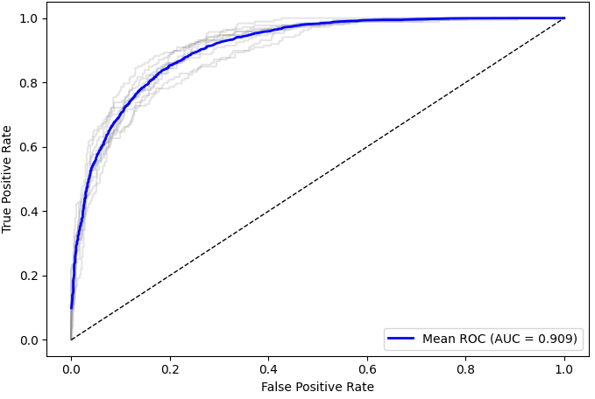
LightGBM
Feature Importance
Confusion Matrix
Evaluation Metrics
Actual
Metric
Recall | 66.5%
F1 Score | 70.1%
Error Type I (%) | 11.7%
Error Type II (%) | 25.8%
 | True | False
True | 1,242 | 627
False | 431 | 4,743
Predicted
Optimal Tuning
ROC Curve
Parameter
learning_rate | 0.05
max_depth | 3
Notes:
To address our research question, we used the publicly available Telco Customer Churn dataset from Kaggle.
It contains records for over 7,000 customers from a U.S. telecommunications company, with 50 different features describing each customer.
These features include both numerical variables like tenure, monthly charges,
categorical variables like contract type, payment method, and internet service type.
Our target variable is binary — whether the customer churned or not.
An important characteristic of this dataset is class imbalance: only about a quarter of customers in the data have churned.
This imbalance has implications for how we train and evaluate our models, since accuracy alone could be misleading.

Slide 11
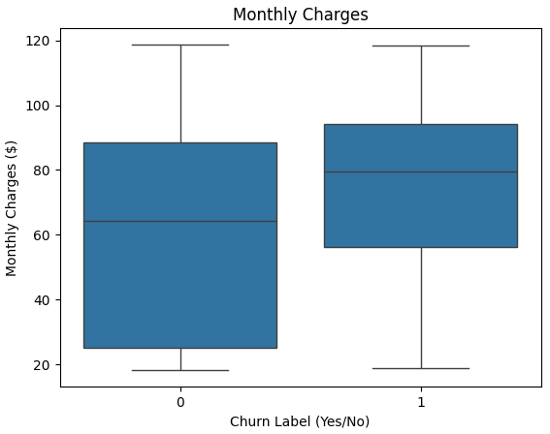
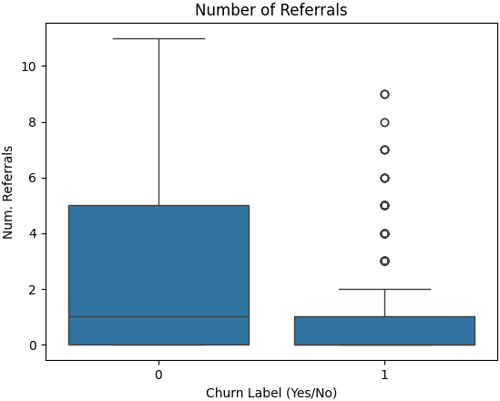
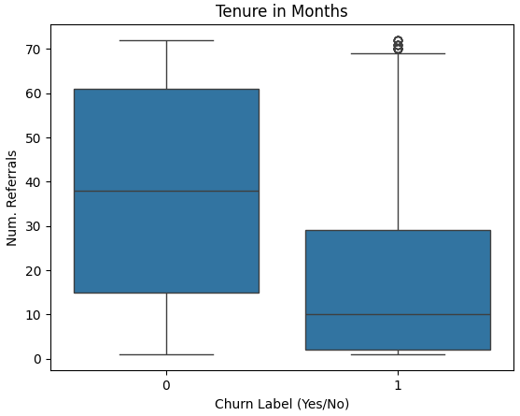
LightGBM – Best Predictors
The median of churned customers was much higher ($74.4) against active customers ($61.3).
This can be interpreted as a competitor movement.
The median referral count shows a clear sign of customer engagement as Active Customers averaged at 2.5, while Churned group at 0.5.
Median Tenure is also a clear sign of customer engagement, and the medians are highly different – 40 months for active customers and 10 for churned.
Notes:
To address our research question, we used the publicly available Telco Customer Churn dataset from Kaggle.
It contains records for over 7,000 customers from a U.S. telecommunications company, with 50 different features describing each customer.
These features include both numerical variables like tenure, monthly charges,
categorical variables like contract type, payment method, and internet service type.
Our target variable is binary — whether the customer churned or not.
An important characteristic of this dataset is class imbalance: only about a quarter of customers in the data have churned.
This imbalance has implications for how we train and evaluate our models, since accuracy alone could be misleading.

Slide 12
Final Thoughts and Recommendations
Modelling
Metrics were similar across models, but one clearly stood out. It had the lowest error rate while performing well on other metrics.
One quarter of data already predicts churn with high accuracy.
New Metrics and Results
Add Customer Care Success Rate: tracks cancellation attempts and outcomes.
Price (Monthly Charges) is the main churn driver—requires a deep study in margin vs. customer retention
Notes:
To address our research question, we used the publicly available Telco Customer Churn dataset from Kaggle.
It contains records for over 7,000 customers from a U.S. telecommunications company, with 50 different features describing each customer.
These features include both numerical variables like tenure, monthly charges,
categorical variables like contract type, payment method, and internet service type.
Our target variable is binary — whether the customer churned or not.
An important characteristic of this dataset is class imbalance: only about a quarter of customers in the data have churned.
This imbalance has implications for how we train and evaluate our models, since accuracy alone could be misleading.

Slide 13
References
IBM Team, “Telco customer churn,” Kaggle, 2024. [Online]. Available: https://doi.org/10.34740/KAGGLE/DSV/8360350. [Accessed: 28-Jul-2025].
S. Kumar, “Customer Retention Versus Customer Acquisition,” Forbes, 12-Dec-2022. [Online]. Available: https://www.forbes.com/councils/forbesbusinesscouncil/2022/12/12/customer-retention-versus-customer-acquisition/. [Accessed: 02-Aug-2025].
Bhatnagar, R., Mehta, K. and Mehta, R., 2013. A comparative study of classification techniques in data mining algorithms. Oriental Journal of Computer Science & Technology, 6(1), pp.117–122.

Slide 14
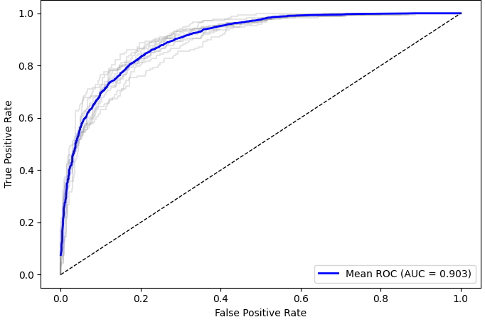
Logistic Regression
Feature Importance
Confusion Matrix
Actual
 | True | False
True | 1,251 | 618
False | 483 | 4,691
Predicted
ROC Curve
Evaluation Metrics
Metric
Recall | 66.9%
F1 Score | 69.4%
Error Type I (%) | 11.6%
Error Type II (%) | 27.9%
Notes:
To address our research question, we used the publicly available Telco Customer Churn dataset from Kaggle.
It contains records for over 7,000 customers from a U.S. telecommunications company, with 50 different features describing each customer.
These features include both numerical variables like tenure, monthly charges,
categorical variables like contract type, payment method, and internet service type.
Our target variable is binary — whether the customer churned or not.
An important characteristic of this dataset is class imbalance: only about a quarter of customers in the data have churned.
This imbalance has implications for how we train and evaluate our models, since accuracy alone could be misleading.

Slide 15
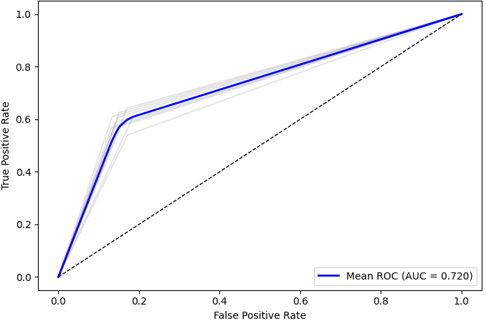
Decision Tree
Feature Importance
Confusion Matrix
Actual
 | True | False
True | 1,111 | 758
False | 797 | 4,377
Predicted
ROC Curve
Evaluation Metrics
Metric
Recall | 59.4%
F1 Score | 58.9%
Error Type I (%) | 14.8%
Error Type II (%) | 41.8%
Notes:
To address our research question, we used the publicly available Telco Customer Churn dataset from Kaggle.
It contains records for over 7,000 customers from a U.S. telecommunications company, with 50 different features describing each customer.
These features include both numerical variables like tenure, monthly charges,
categorical variables like contract type, payment method, and internet service type.
Our target variable is binary — whether the customer churned or not.
An important characteristic of this dataset is class imbalance: only about a quarter of customers in the data have churned.
This imbalance has implications for how we train and evaluate our models, since accuracy alone could be misleading.

Slide 16
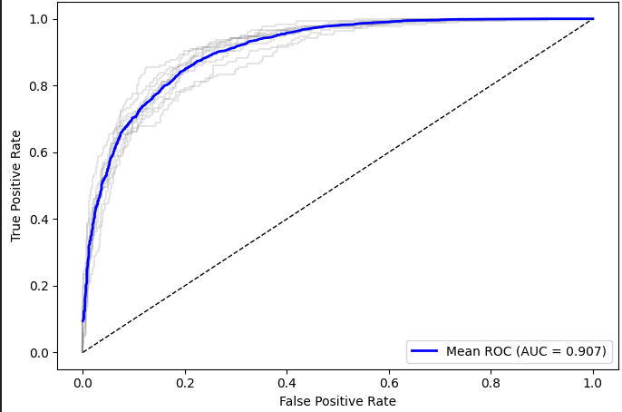
XGBoost
Feature Importance
Confusion Matrix
Actual
 | True | False
True | 1,212 | 657
False | 474 | 4,700
Predicted
ROC Curve
Evaluation Metrics
Metric
Recall | 67.5%
F1 Score | 70.8%
Error Type I (%) | 12.3%
Error Type II (%) | 28.1%
Notes:
To address our research question, we used the publicly available Telco Customer Churn dataset from Kaggle.
It contains records for over 7,000 customers from a U.S. telecommunications company, with 50 different features describing each customer.
These features include both numerical variables like tenure, monthly charges,
categorical variables like contract type, payment method, and internet service type.
Our target variable is binary — whether the customer churned or not.
An important characteristic of this dataset is class imbalance: only about a quarter of customers in the data have churned.
This imbalance has implications for how we train and evaluate our models, since accuracy alone could be misleading.

Slide 17
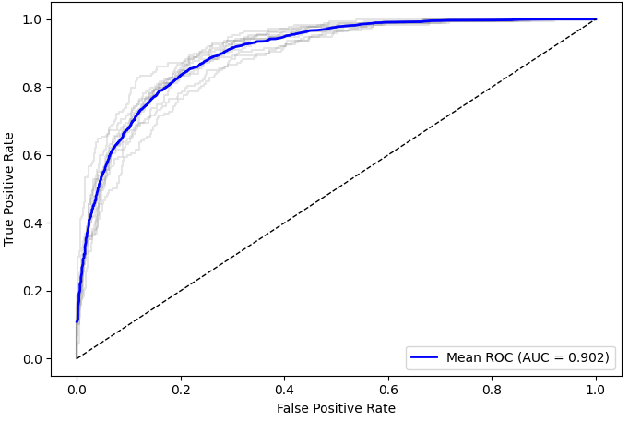
Random Forest
Feature Importance
Confusion Matrix
Actual
 | True | False
True | 1,155 | 353
False | 714 | 4,821
Predicted
ROC Curve
Evaluation Metrics
Metric
Recall | 61.2%
F1 Score | 68.4%
Error Type I (%) | 6.8%
Error Type II (%) | 38.2%
Notes:
To address our research question, we used the publicly available Telco Customer Churn dataset from Kaggle.
It contains records for over 7,000 customers from a U.S. telecommunications company, with 50 different features describing each customer.
These features include both numerical variables like tenure, monthly charges,
categorical variables like contract type, payment method, and internet service type.
Our target variable is binary — whether the customer churned or not.
An important characteristic of this dataset is class imbalance: only about a quarter of customers in the data have churned.
This imbalance has implications for how we train and evaluate our models, since accuracy alone could be misleading.

